Slide 1
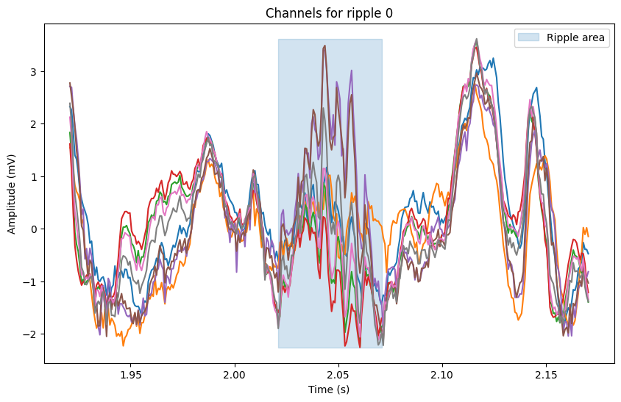
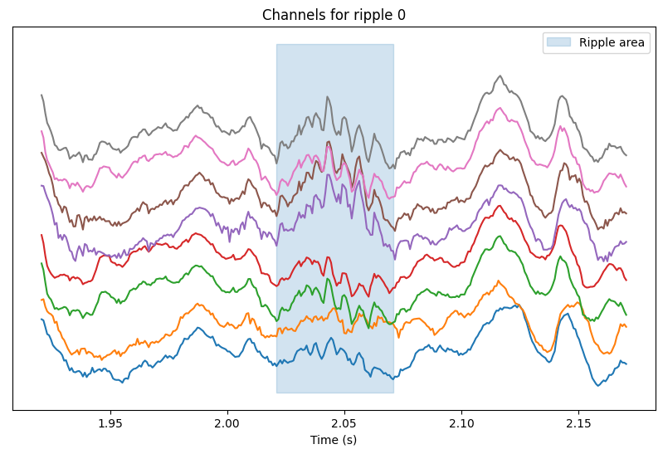



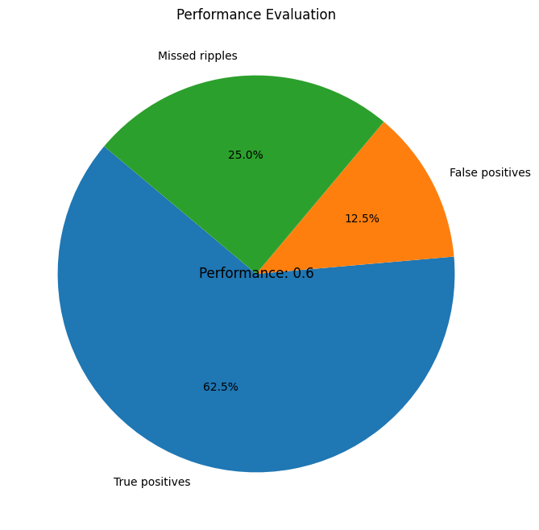

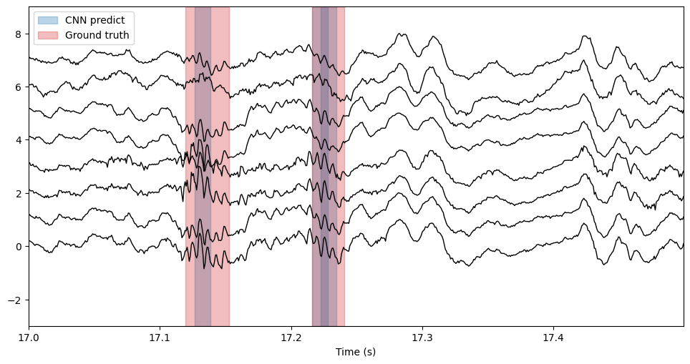

Liset IN-VIVO data ML toolkit
DOCUMENTATION

Slide 2




1 – Build the environment
1 – Install Conda (visit https://www.anaconda.com/download)
2 – Create the environment using command:
conda env create -f rippl_AI_env.yml

Slide 3

The library
The library is composed of files:
liset_tk.py (containing the class)
Liset_aux.py (auxiliar functions)
Load_data.py (functions to load data, though liset_tk also has some.)
bz_LoadBinary.py (load binary data, though liset_tk also has its own)
Format_predictions.py (aid in inference with models)
liset_tk.py
Bz_LoadBinary.py
Liset_aux.py
Load_data.py
Format_predictions.py

Slide 4
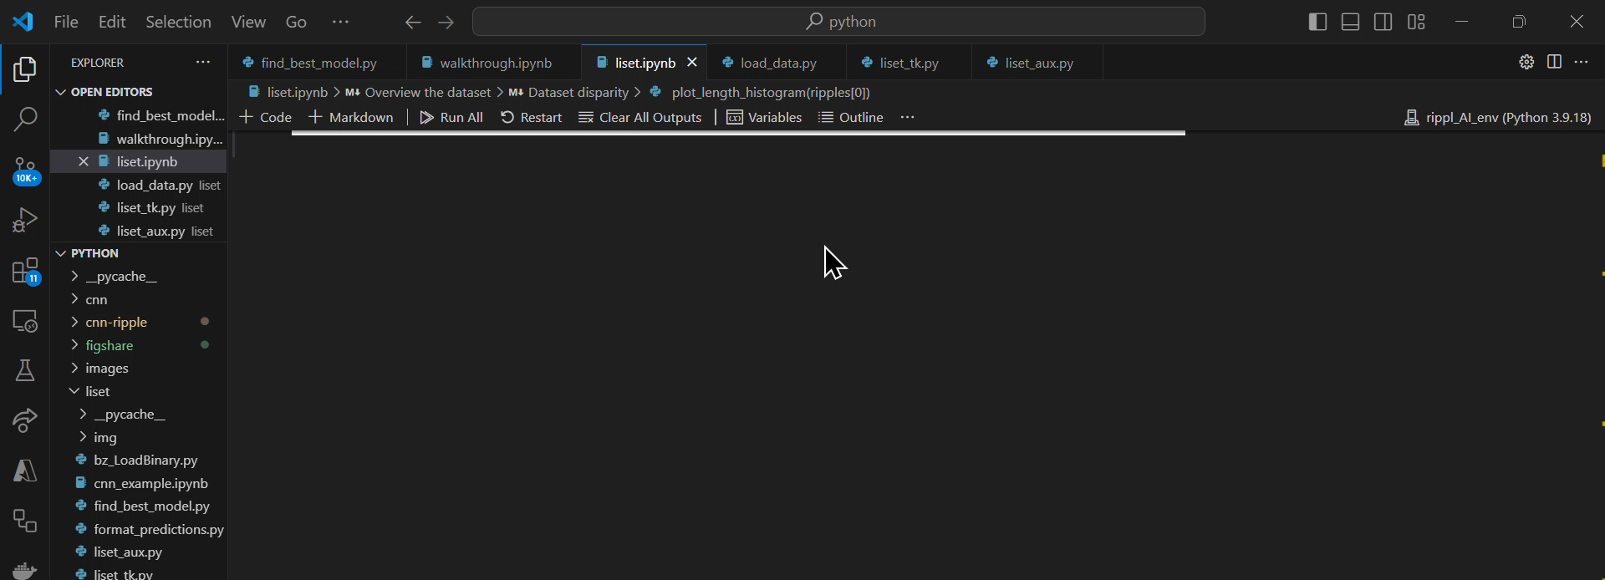
Example usage
Follow walkthrough.ipynb to learn the usage of the toolkit ☺.
If you are not familiar with .ipynb notebook files, install visual studio code and follow this tutorial:
https://www.youtube.com/watch?v=9V7AoX0TvSM
To connect to the created Virtual Environment with the .yml file in vscode:

